Slide 1

Main Project Seminar
On
Fake News Detection using different Machine Learning models

Slide 2

Gayatri Vidya Parishad College of Engineering
(Autonomous)
Madhurawada,Visakhapatnam-530 048
Under the esteemed guidance of
S. Kanthi Kiran
Associate Professor
Department of Information Technology
Project Team Members
K. Anusha 17131A1251
B. Kamal 17131A1217
A. Amruth 17131A1210
K. Aditya Pavan 17131A1255

Slide 3
CONTENTS
ABSTRACT
EXISTING SYSTEM
PROPOSED SYSTEM
OUTPUT SCREENS
CONCLUSION
REFERENCES

Slide 4
ABSTRACT
Social media interaction especially the news spreading around the network is a great source of information now-a-days.
Twitter being a standout amongst the most well-known ongoing news sources additionally ends up a standout amongst the most dominant news radiating mediums.
Fake News have great impact on business and commerce.

Slide 5
Existing System
Several features have been proposed and evaluated in view of the impact of features on the accuracy of the classifier.
In the existing work, the system uses only to semi-supervised learning. Only Text Classification as sentiment text and it never finds fake news.

Slide 6
Disadvantages :
In the existing work, the system uses only to semi-supervised learning.
Only Text Classification as sentiment text and it never finds fake news.

Slide 7
Proposed System
To overcome the drawbacks of the existing algorithms, the proposed algorithm has been evolved.
Our algorithm primarily focuses on classifying news into real and fake efficiently with high accuracy by using NLP models.

Slide 8
Advantages:
The system is very fast and effective due to semi-supervised and supervised learning.
Focused on the content of the news based approaches. As feature we have used count vector ,TF-IDF and N-vector.

Slide 9
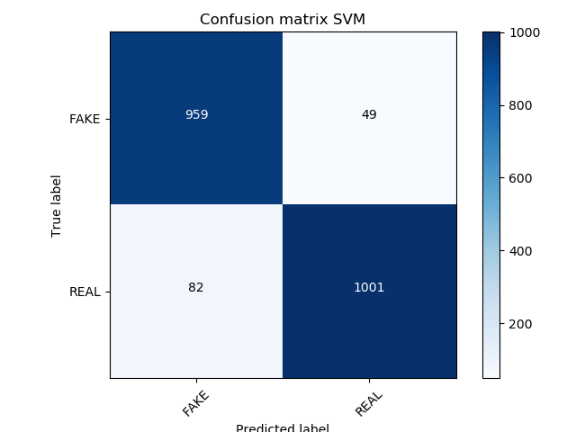
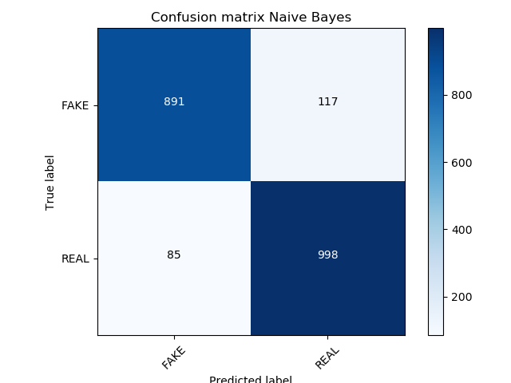

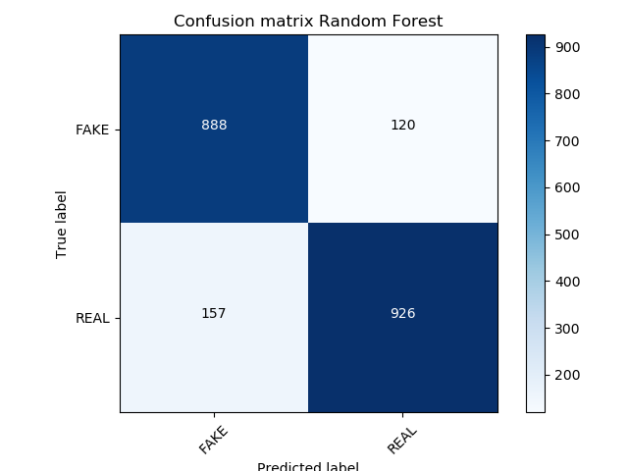
Confusion matrix of algorithms

Slide 10
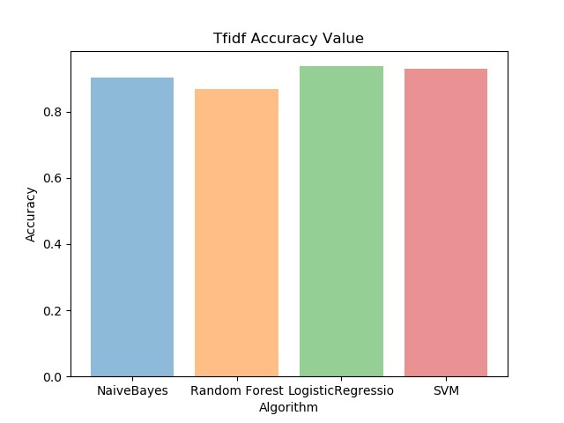
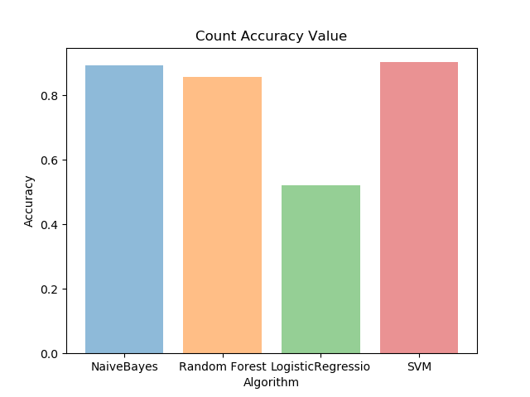
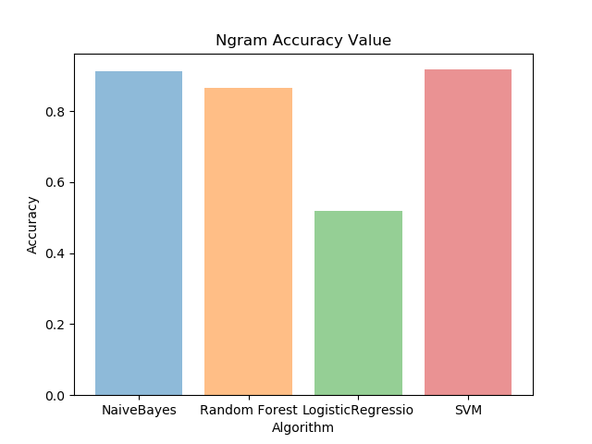
Comparing Accuracy

Slide 11
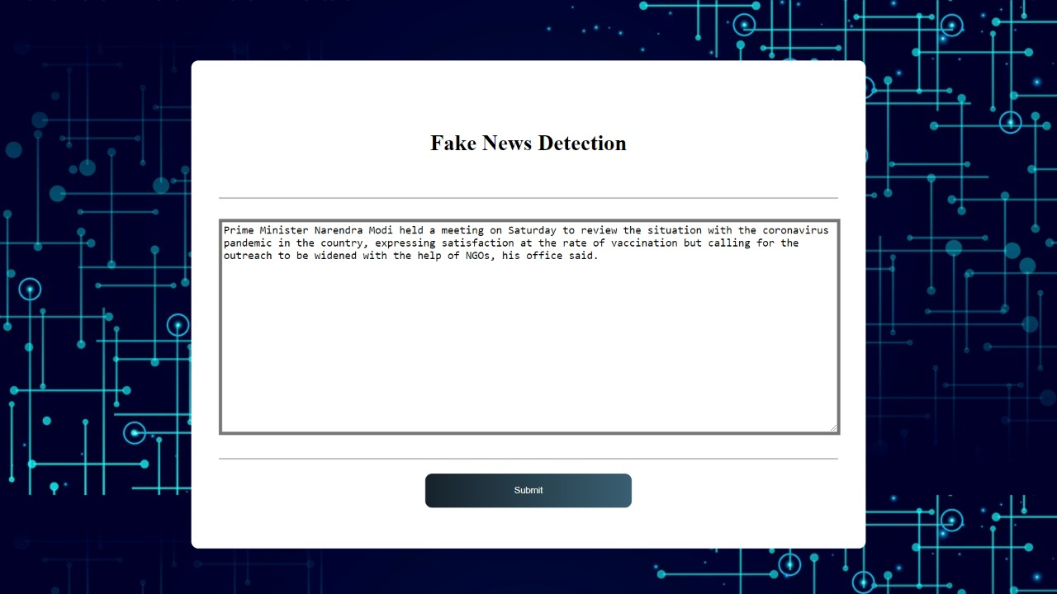
Output Screens

Slide 12
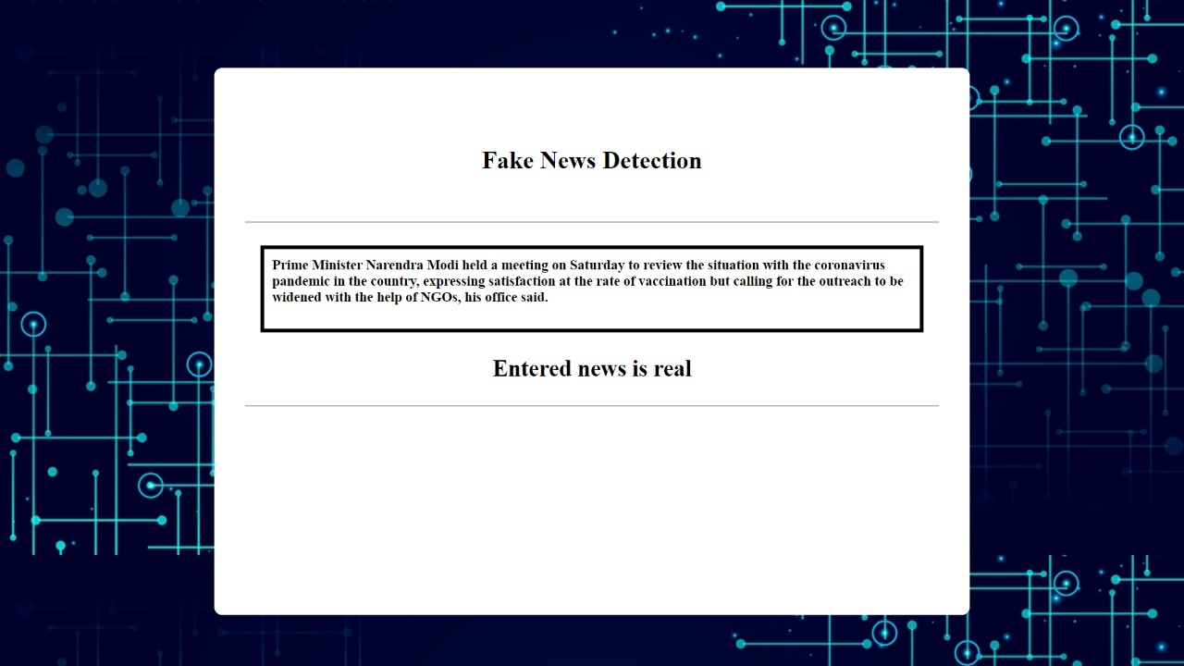

Slide 13
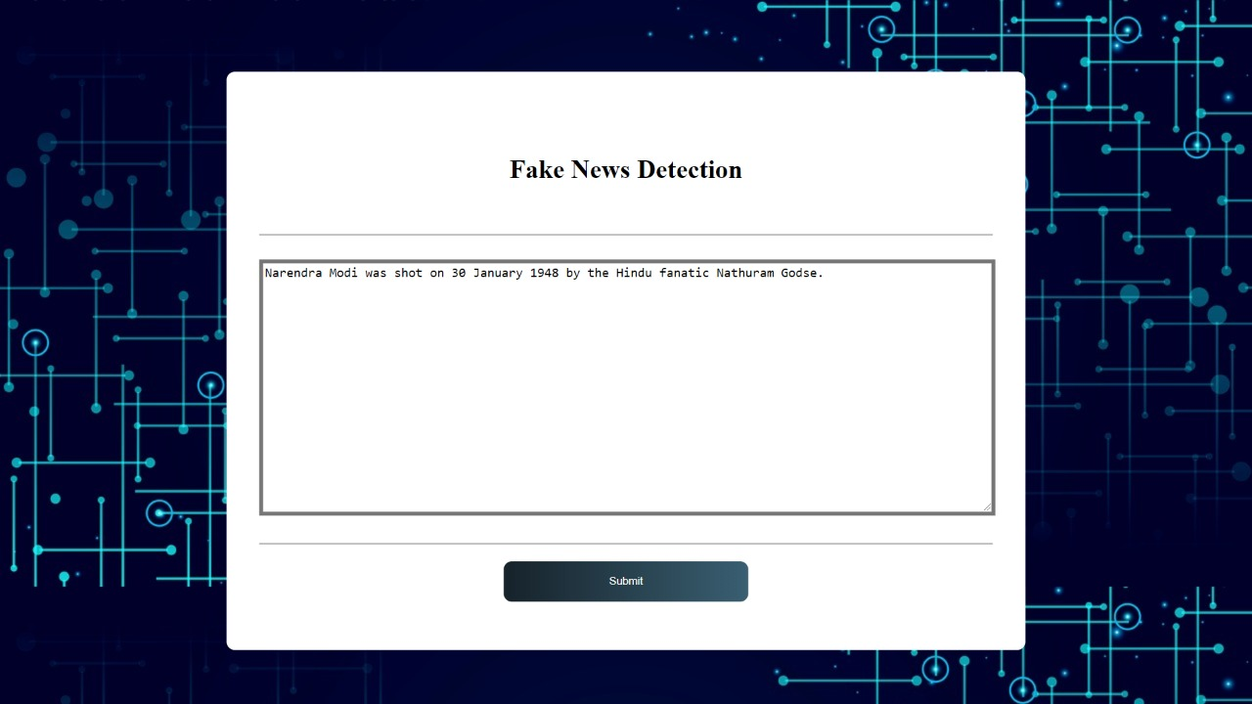

Slide 14
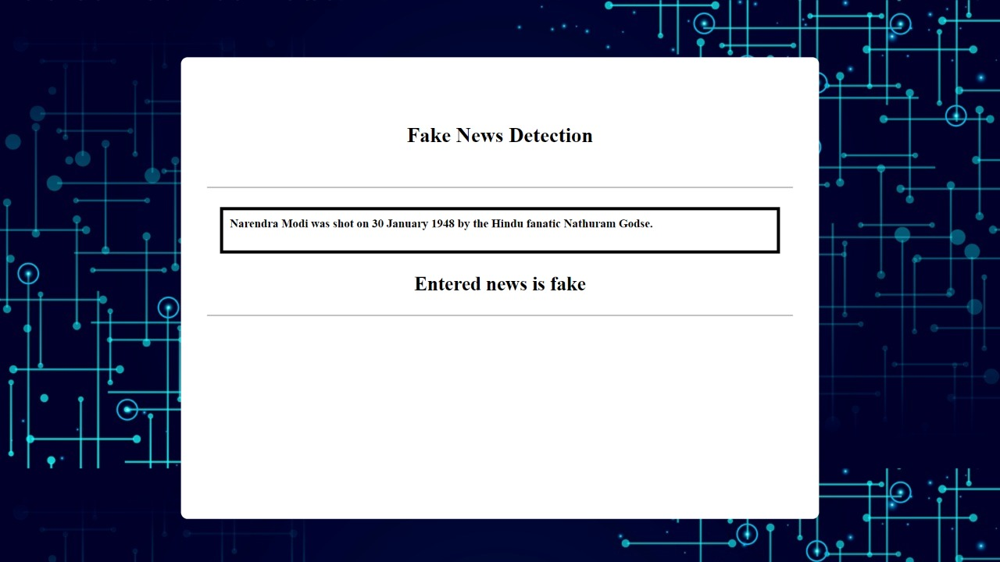

Slide 15
Conclusion
We analyzed a computerized model for checking the verification of news in media i.e., real news or fake news.
Machine Learning may find a decent outcome on such a critical issue as the spread of fake news issues worldwide. Accordingly, the aftereffects of this examination propose much more, that systems like this might come very much handy and be effectively used to handle this critical issue.
The dataset in this analysis is relied upon machine learning based statistical calculations like Support Vector Machines (SVM), Naive Bayes (NB), Logistic Regression (LR), Random Forest (RF). In this analysis , Logistic Regression performs best for characterization technique.

Slide 16
REFERENCES
Conroy, Niall & Rubin, Victoria & Chen, Yimin. (2015). Automatic Deception Detection: Methods for Finding Fake News. USA
Ball, L. & Elworthy, J. J Market Anal (2014) 2: 187. https://doi.org/10.1057/jma.2014.15
Lu TC. Yu T., Chen SH. (2018) Information Manipulation and Web Credibility. In: Bucciarelli E., Chen SH., Corchado J. (eds) Decision Economics: In the Tradition of Herbert A. Simon's Heritage. DCAI 2017. Advances in Intelligent Systems and Computing, vol 618. Springer, Cham
Rubin, Victoria & Conroy, Niall & Chen, Yimin & Cornwell, Sarah. (2016). Fake News or Truth? Using Satirical Cues to Detect Potentially Misleading News.10.18653/v1/W160802.
Kaggle Dataset : https://www.kaggle.com/nopdev/real-and-fake-news-dataset

Slide 17
Thank You

